Slide 1


Meetup
Cincinnati
May 2021

Slide 2
Agenda
Intro to HTB Cincinnati!
Polls
Blue (easy, windows)
Review
Bashed (easy, linux)
Story
Hands-on
Walkthrough
Love (easy, windows)
Walkthrough
Cereal (hard, windows)
Hands-on
 Intro ~25 minutes
 Polls ~5 minutes
 Blue ~10 minutes
 Bashed~ 40 minutes
 Love~ 40 minutes
 Cereal remaining time

Slide 3
Introduction
Welcome to the Cincinnati HackTheBox Meetup!
The Goal
Give Cincinnati (+ surrounding areas ☺) a forum to collaborate and enjoy HackTheBox
Help people grow and learn about hacking
Networking
Have fun!
Notes:
At the end of the day, this meetup is for you.

Slide 4
Updates
A few house keeping items
Feedback
Extremely appreciated!
We’ll work toward making these a bi-weekly meeting
We’ll continue to ask for feedback on when we move forward and add new machines
No hackers left behind!
Guacamole boxes are still useful for now
Upcoming poll will gauge interest in ‘battlegrounds style’ meetup
Notes:
At the end of the day, this meetup is for you.

Slide 5

> whoami
My name is Austin Marck - ‘Cryo’
I’ve been playing HTB for a few years
Born and raised in Cincinnati
Day Job - Penetration Tester / R&I
Sr Principal Sec Eng
Talks at Defcon and other security conferences
Hobbies include kayaking in the summer and failing to find rare bourbon in the winter
HTB: https://www.hackthebox.eu/home/users/profile/23771
Twitter: https://twitter.com/icryo
Notes:
At the end of the day, this meetup is for you.

Slide 6

Who do we have this week?
Name
Have you ever played a CTF
Experience with HTB
Fun fact / something you’d like everyone to know
Notes:
At the end of the day, this meetup is for you.

Slide 7

Perks of joining a HTB meetup
SWAG
HTB membership giveaways
Dedicated labs
Early access and sneak peaks
Walkthroughs on Active Machines
Provided food & event space (one day we hope)
Notes:
At the end of the day, this meetup is for you.

Slide 8

Notes:
At the end of the day, this meetup is for you.

Slide 9

(ISC)2 CPE
HTB is an official (ISC)2 submitter
CPE Credits submission will be available to our VIP members. Our VIP members can obtain credits, by completing Hack The Box Machines, Challenges, Endgames and Pro Labs. In order to start tracking your activity and automatically get your credits, you need to enable this option through your account settings.
Active Machines
Easy (2), Medium (4), Hard (6), Insane (8)
Retired Machines
Easy (1), Medium (2), Hard (3), Insane (4)
Challenges
Easy (1), Medium (2), Hard (3), Insane (4)
https://www.hackthebox.eu/newsroom/cpe-credits
Notes:
At the end of the day, this meetup is for you.

Slide 10


Slide 11


Slide 12
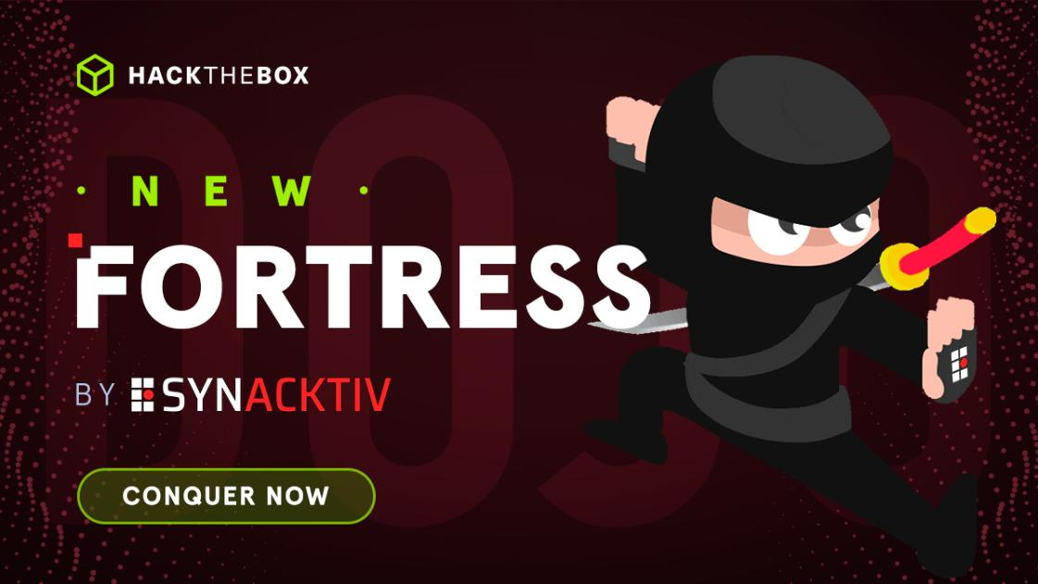
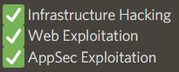
This Month in HTB

Slide 13

Join the Discord
https://discord.com/download
https://discord.gg/KZVaSNdbAA

Slide 14

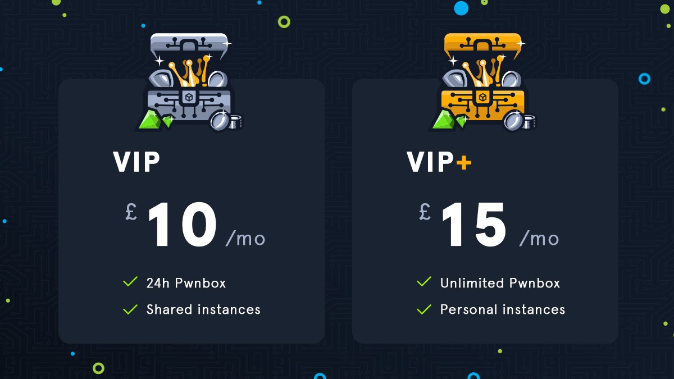
HTB Membership Tiers
HTB Giveaway at the end of the meetup!
Free (active machines + recently retired)
VIP (semi-private access to all machines)
VIP+ (private machines + unlimited pwnbox)
Notes:
https://www.virtualbox.org/wiki/Downloads
https://images.kali.org/virtual-images/kali-linux-2021.1-vbox-amd64.ova

Slide 15
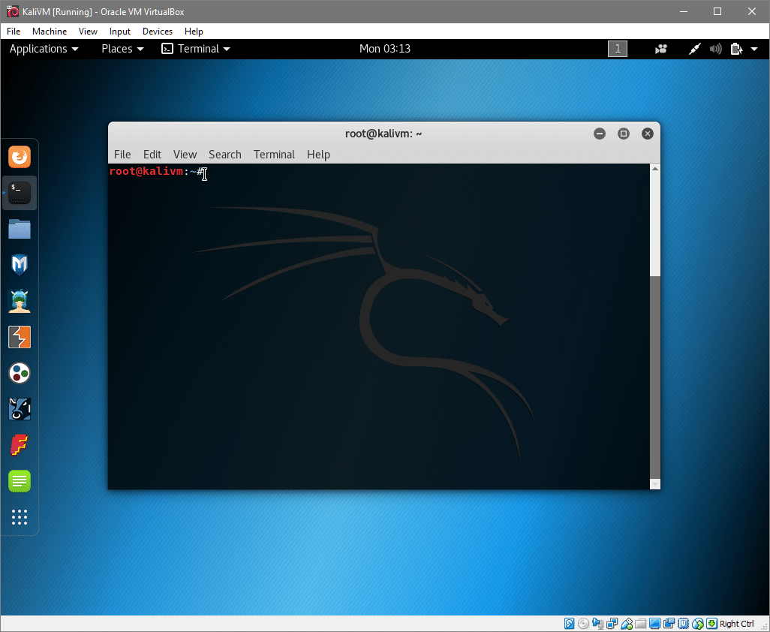
VM Setup
Virtual Machine
Bare-Metal
Windows Subsystem for Linux (WSL)
Pwnbox
Cloud Hosted
Onworks
Notes:
https://www.virtualbox.org/wiki/Downloads
https://images.kali.org/virtual-images/kali-linux-2021.1-vbox-amd64.ova

Slide 16
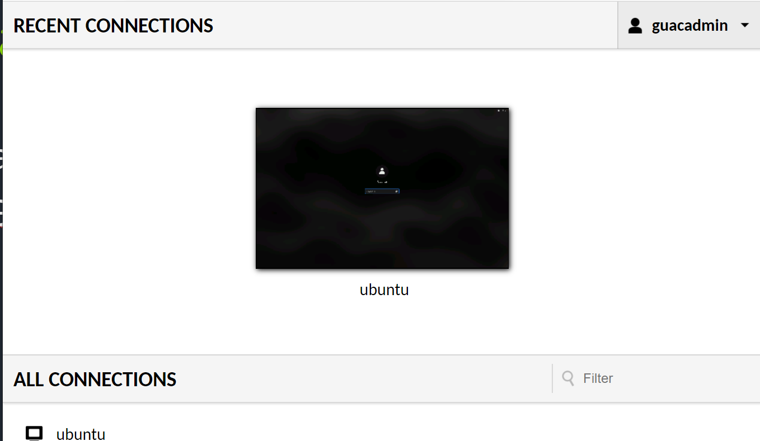

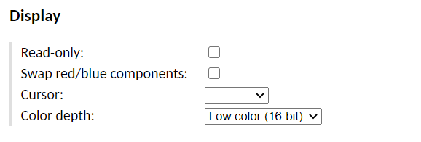
Guacamole
Username: guacadmin
Pass: guacadmin
Password: skylinetime
Notes:
Another option is to use this apache guacamole server that I’ve setup
These are hosted in AWS and will be deleted immediately following the meetup
They aren’t as cool as pwnbox, but they do have the benefit of being ‘shareable’ which means that I can remotely take control and help you through something if you hit a wall.

Slide 17
Break


Slide 18
Poll
☑

Slide 19
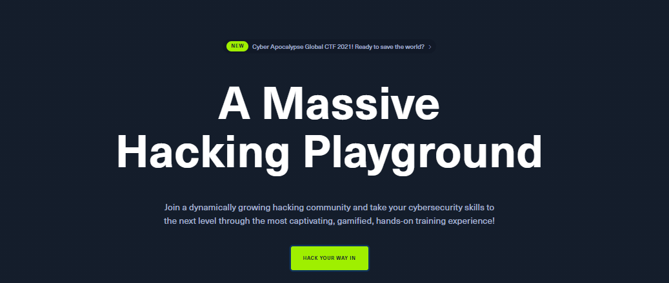
Joining HackTheBox
Generating an invite code
Notes:
https://www.virtualbox.org/wiki/Downloads
https://images.kali.org/virtual-images/kali-linux-2021.1-vbox-amd64.ova

Slide 20
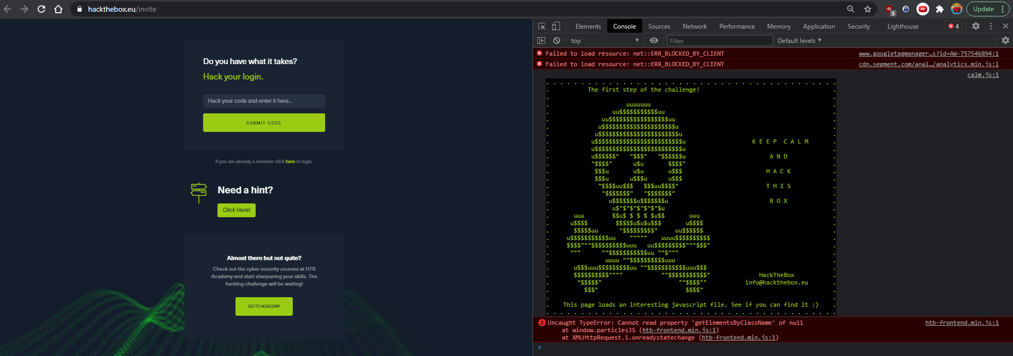
CNTRL + SHIFT + I “DevTools”

Slide 21
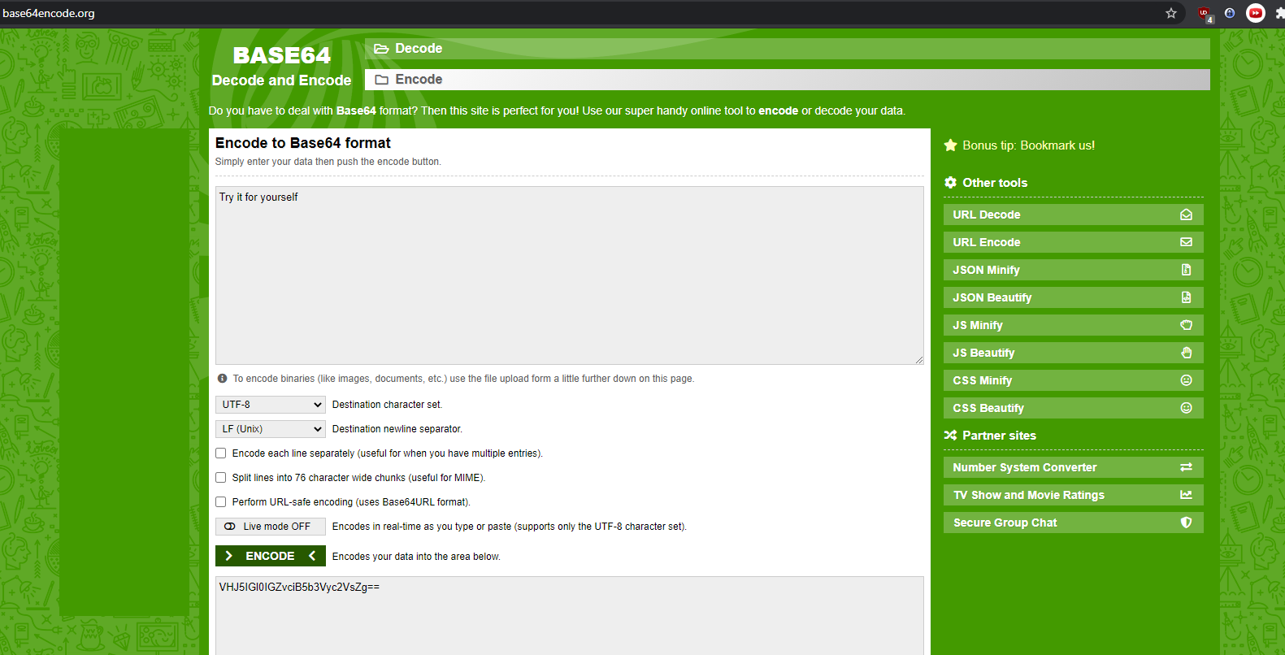
What is base64?
https://www.base64encode.org/
https://www.base64decode.org/
Notes:
https://www.virtualbox.org/wiki/Downloads
https://images.kali.org/virtual-images/kali-linux-2021.1-vbox-amd64.ova

Slide 22

How to CURL
GET, POST, PUT, DELETE, CONNECT, OPTIONS, TRACE, PATCH
Curl –x POST https://www.hackthebox.eu/api/invite/generate
RFC for common HTTP Methods: https://tools.ietf.org/html/rfc7231#section-4

Slide 23
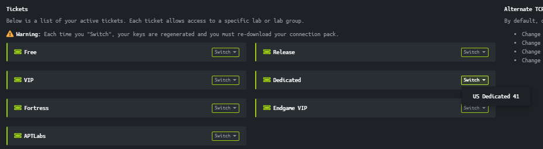
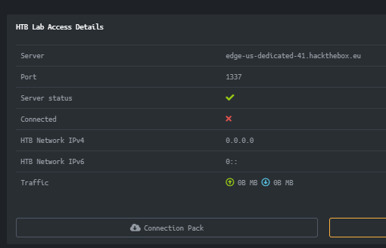
Connecting to the LAB
Send me your HTB username
Login to hackthebox.eu
Click VIEW HTB CLASSIC at the bottom
Click Access
Click the Switch next to dedicated and select US Dedicated 41
Find the box that says ‘HTB Lab Access Details’ with server:
edge-us-dedicated-41.hackthebox.eu 7. Click Connection Pack to download
Notes:
https://www.virtualbox.org/wiki/Downloads
https://images.kali.org/virtual-images/kali-linux-2021.1-vbox-amd64.ova

Slide 24
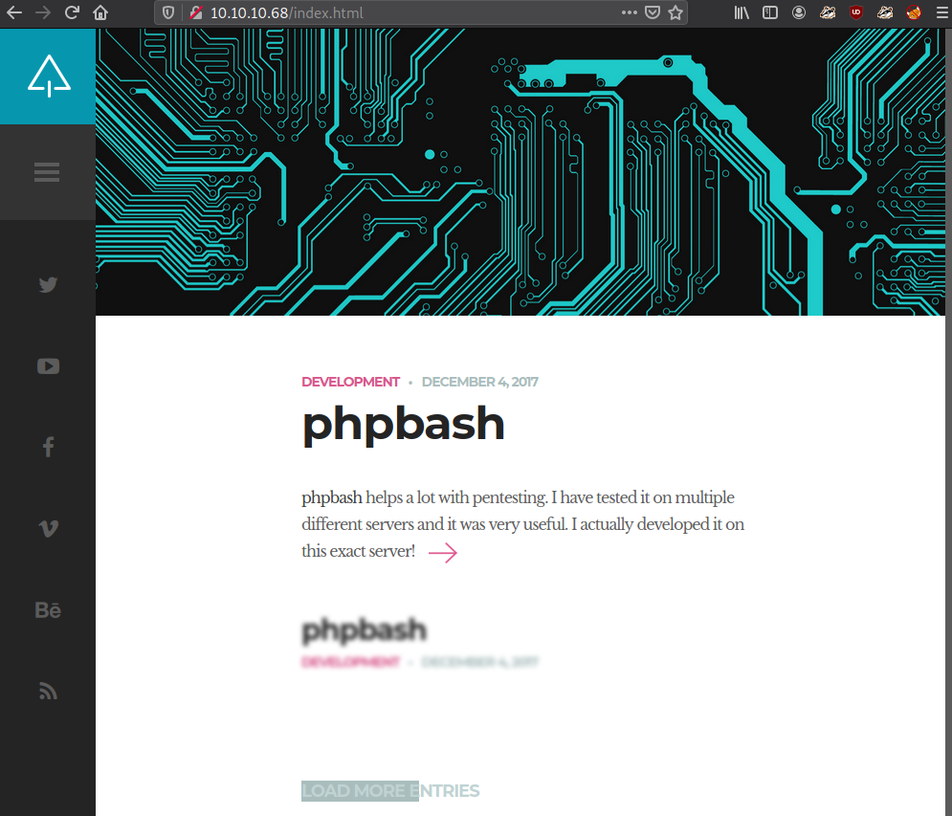
Connecting to the LAB
In terminal type sudo openvpn yourusername.ovpn within the download directory.
You should be able to visit Bashed’s webpage at http://10.10.10.68
Notes:
https://www.virtualbox.org/wiki/Downloads
https://images.kali.org/virtual-images/kali-linux-2021.1-vbox-amd64.ova

Slide 25


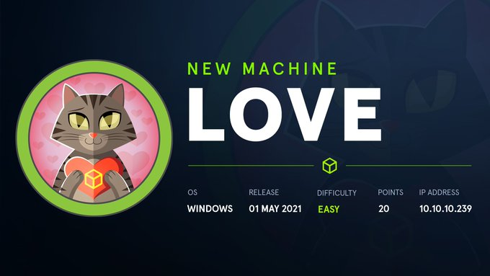
Choose your own adventure
Follow Along!
Soon to retire!
Active box?
Notes:
Because we aren't on a domain joined machine and we've effectively gotten complete compromise lets instead shift our focus to staying on the machine post-exploitation.
Consider types of persistence
https://www.hexacorn.com/blog/2021/03/05/beyond-good-ol-run-key-part-133/
Think through 'bunkering/evasion'
https://github.com/josh0xA/ring3-kit
https://github.com/bytecode77/r77-rootkit
https://www.ired.team/offensive-security/defense-evasion/unloading-sysmon-driver

Slide 26
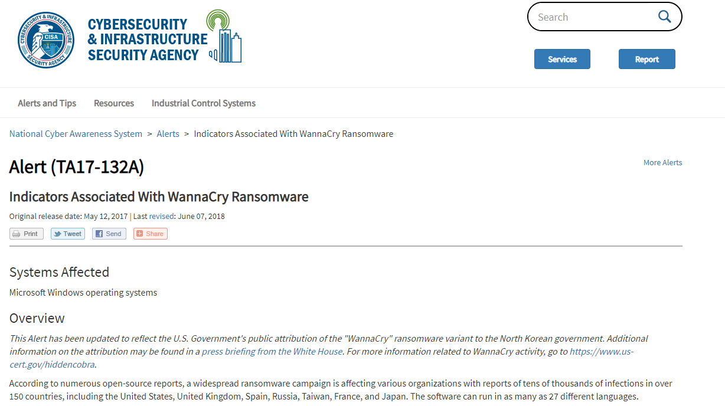
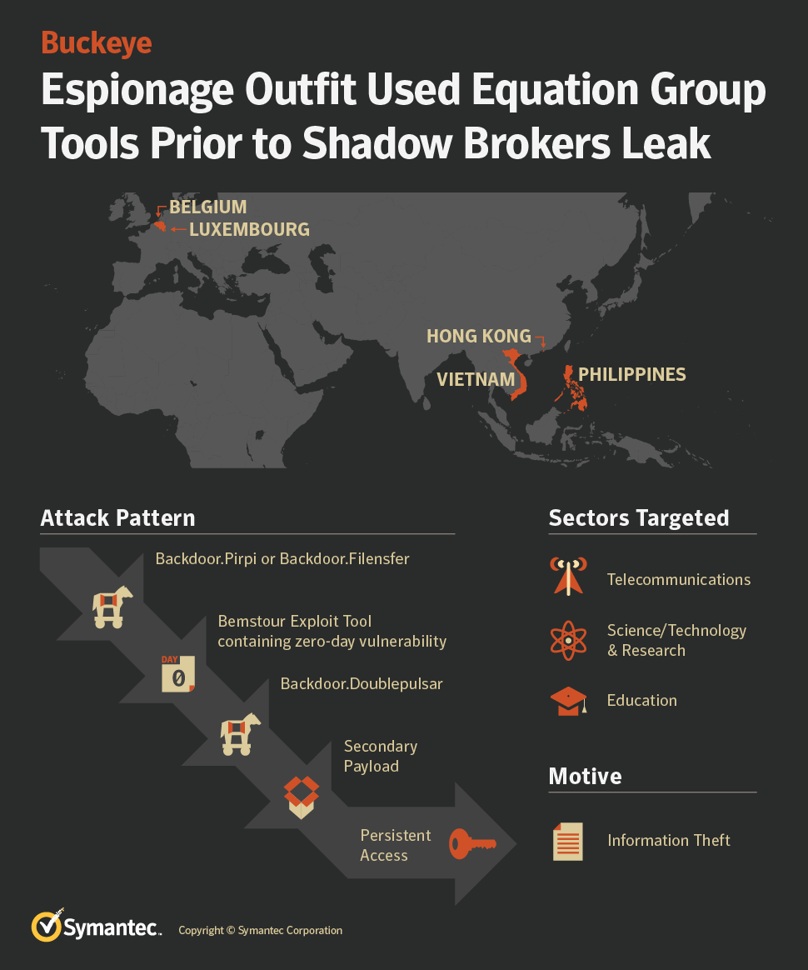
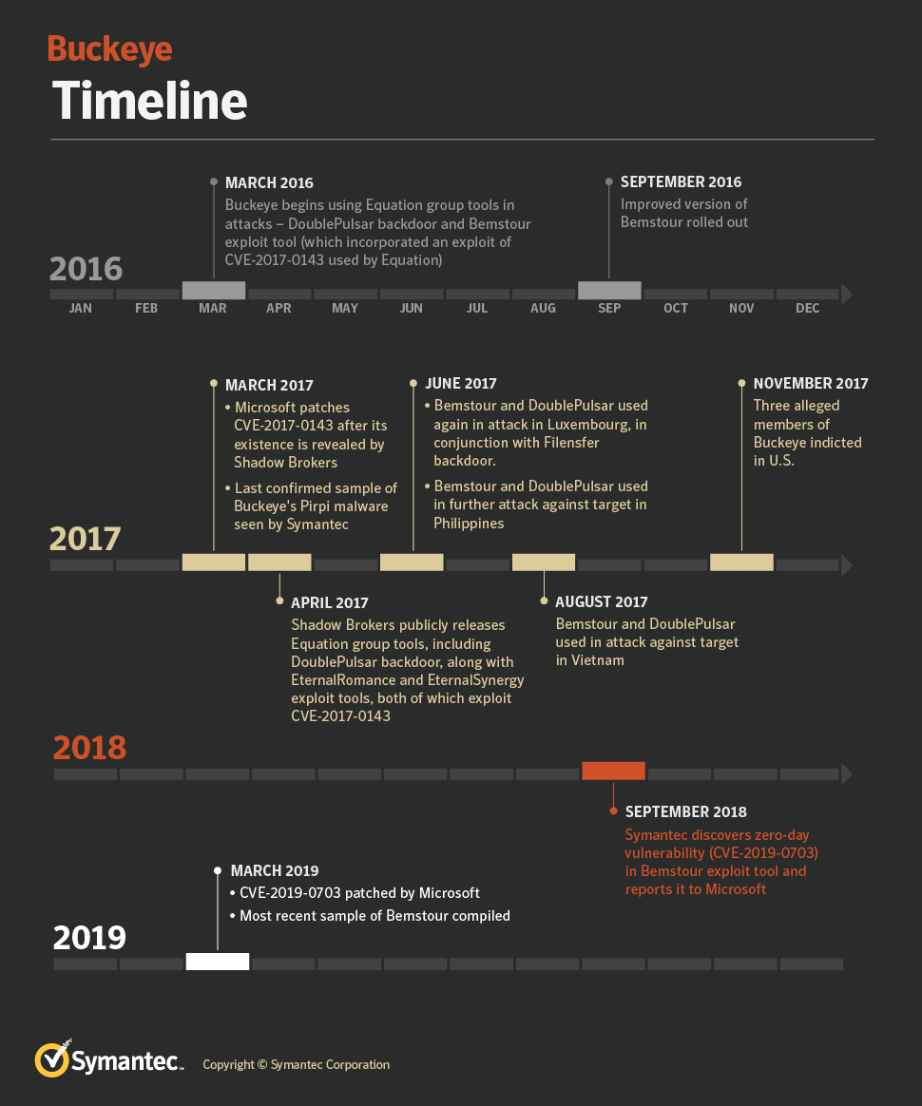
Brief Story
Notes:
Infographics from Symantec
https://risksense.com/wp-content/uploads/2018/05/White-Paper_Eternal-Blue.pdf

Slide 27
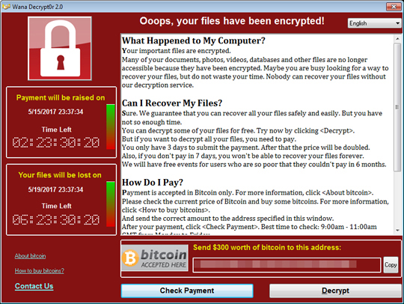
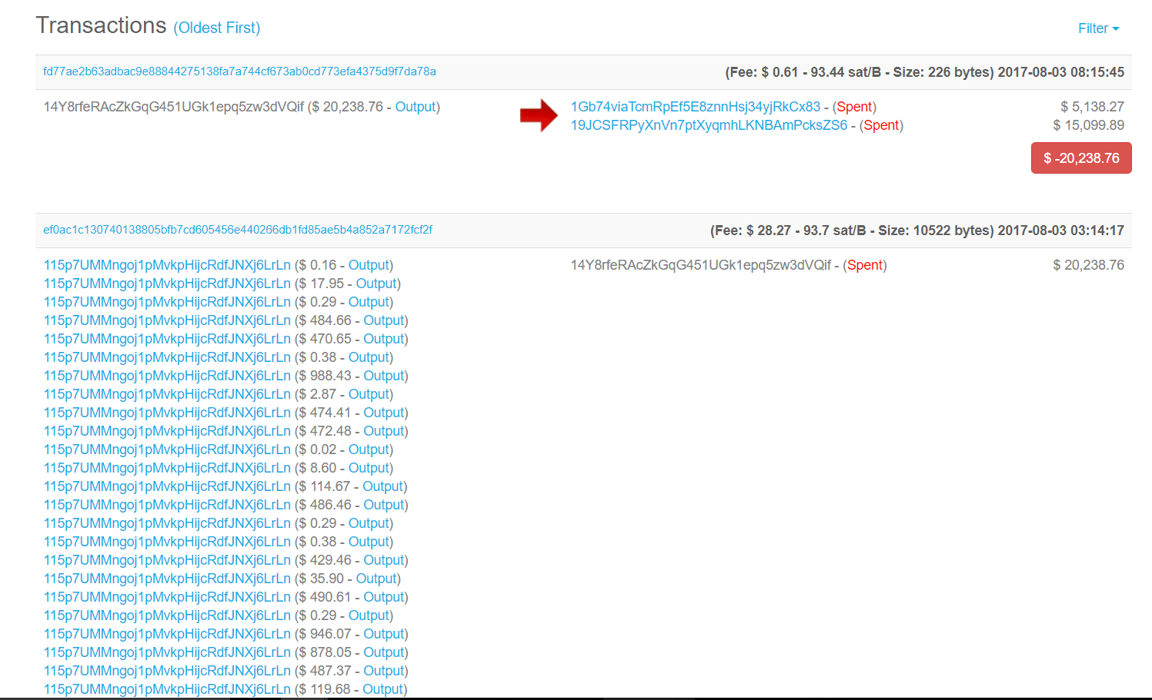
Wannacry
Notes:
Some estimations of the damage caused by wannacry put it in the area of 4 billion dollars in damages globally

Slide 28
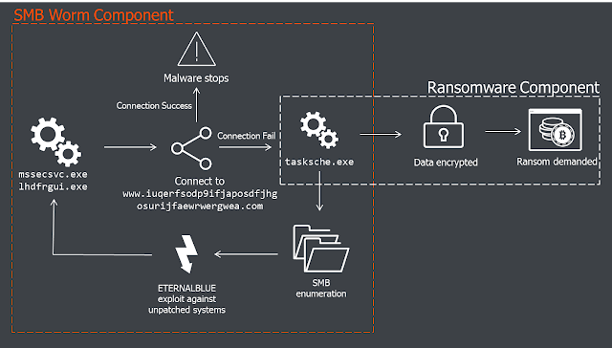
Ransomware spreading
Notes:
https://baesystemsai.blogspot.com/2017/05/wanacrypt0r-ransomworm.html

Slide 29
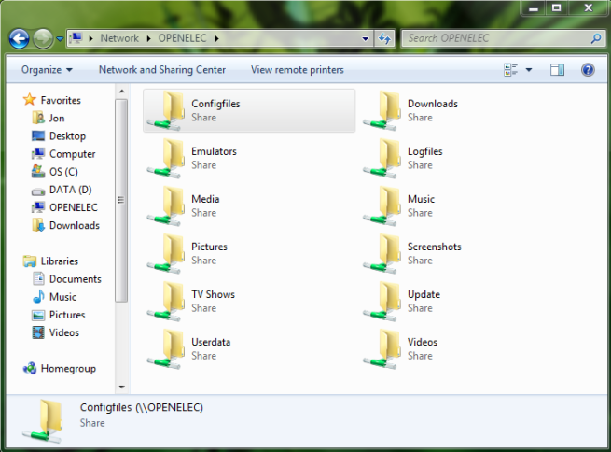
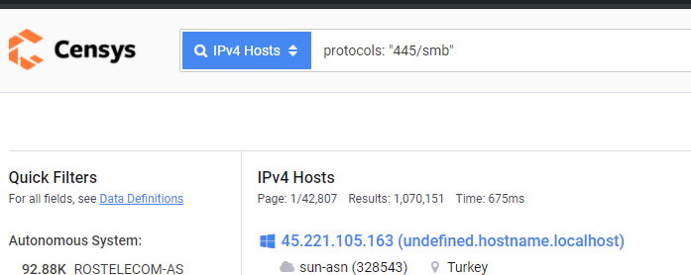
SMB
Server Message Block (SMB) – A communication protocol for providing shared access to files.
https://censys.io/ipv4?q=protocols%3A+%22445%2Fsmb%22&
Notes:
Exposed for nearly every windows machine, for nearly every domain

Slide 30
The vulnerability
Integer Overflow that leads to a buffer overflow within a popular external Microsoft service.
“Every major malware family, from botnets to ransomware to banking spyware, will eventually add the exploits in the FuzzBunch toolkit to their arsenal. This payload is simply a mechanism to load more malware with full system privileges... This is a jewel compared to the scraps that were given to Stuxnet. It comes in a more dangerous era than the days of Conficker. Given the persistence of the missing MS08-067 patch, we could be in store for a decade of breaches emanating from MS17-010 exploits. It is the perfect storm for one of the most damaging malware infections in computing history.” - zerosum0x0

Slide 31

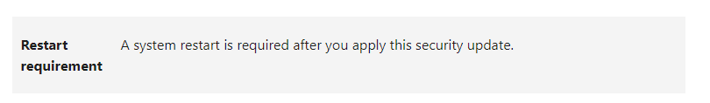
Is this relevant in 2021?
Vendor supplied appliance
“We haven’t fully implemented SCCM”
Incompatibilities with software
Not yet in scope
System uptime
Silo’d teams
Budget
Notes:
This machine came out 4 years ago, certainly everyone has patched against this bug

Slide 32
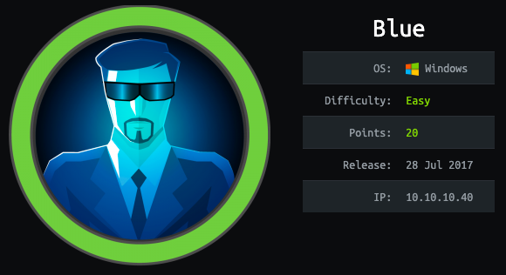
Blue

Slide 33
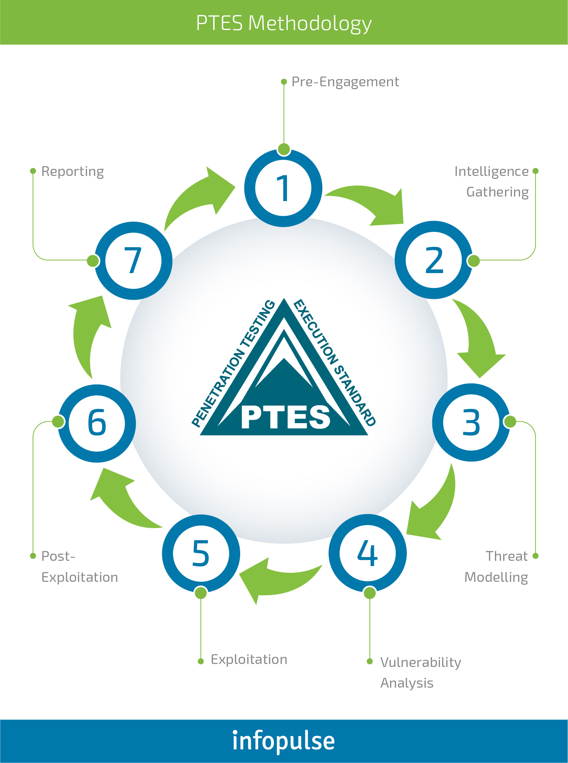
EternalBlue
Pre-Engagement
Intelligence Gathering
Threat Modeling
Vulnerability Analysis
Exploitation
Post-Exploitation
Reporting Flag
http://www.pentest-standard.org/index.php/Main_Page

Slide 34
EternalBlue
Pre-Engagement
Intelligence Gathering
Threat Modeling
Vulnerability Analysis
Exploitation
Post-Exploitation
Reporting Flag
Scope?
https://github.com/juliocesarfort/public-pentesting-reports
https://github.com/OpenSourcePentest/docs
https://github.com/trustedsec/physical-docs
http://www.pentest-standard.org/index.php/Main_Page
Notes:
Get the host machine setup and our network connections working

Slide 35
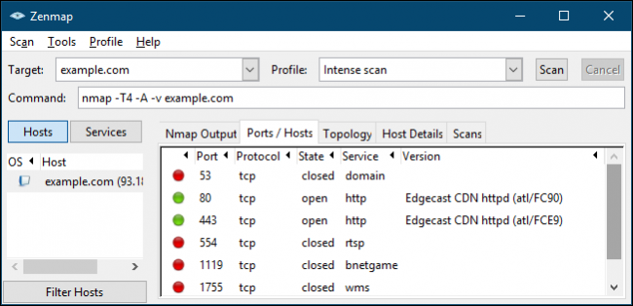
EternalBlue
Pre-Engagement
Intelligence Gathering
Threat Modeling
Vulnerability Analysis
Exploitation
Post-Exploitation
Reporting Flag
The more information you are able to gather during this phase, the more vectors of attack you may be able to use in the future.
http://www.pentest-standard.org/index.php/Main_Page
Notes:
Service fingerprinting

Slide 36
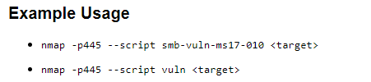
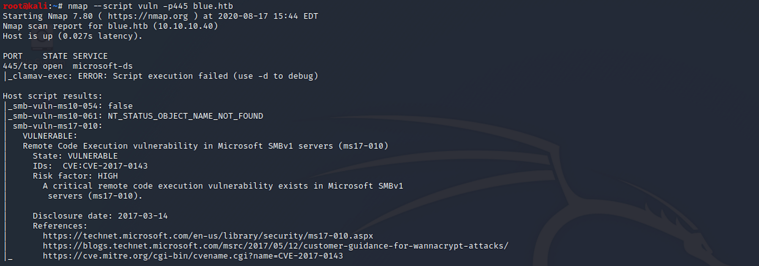
NMAP
Nmap (network mapper) is tool for identifying and enumerating services on remote machines.

Slide 37
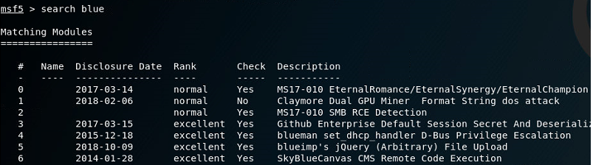
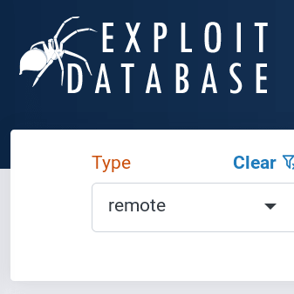
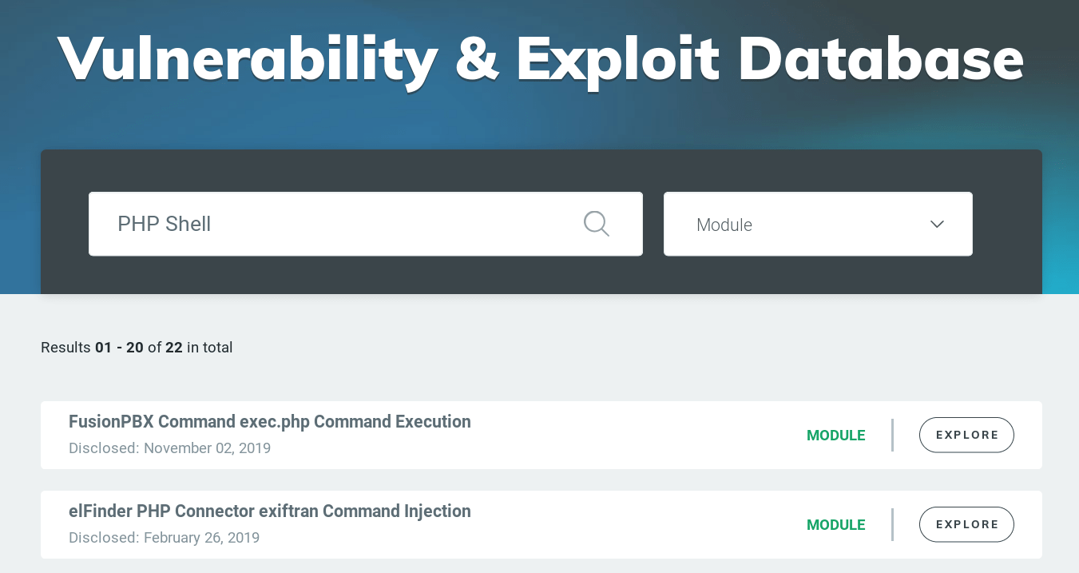
EternalBlue
Pre-Engagement
Intelligence Gathering
Threat Modeling
Vulnerability Analysis
Exploitation
Post-Exploitation
Reporting Flag
Availability of relevant exploits/payloads
http://www.pentest-standard.org/index.php/Main_Page
Notes:
Get the host machine setup and our network connections working

Slide 38
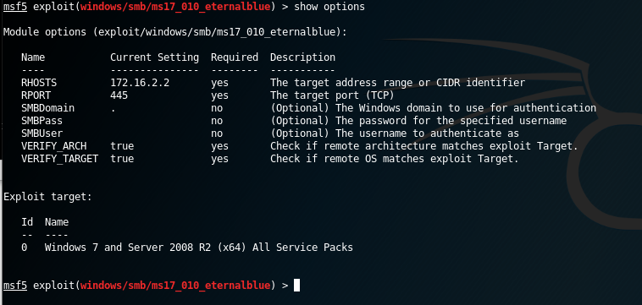
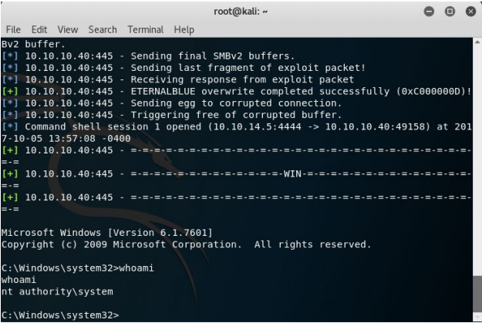
EternalBlue
Pre-Engagement
Intelligence Gathering
Threat Modeling
Vulnerability Analysis
Exploitation
Post-Exploitation
Reporting Flag
searchsploit -m 42315.py
M
http://www.pentest-standard.org/index.php/Main_Page
Notes:
There are plenty of ms17 exploits to choose from and any one of them should be fine for gaining access to this machine. Some may return a meterpreter shell and others might return a standard command shell depending on the payload used. You don’t need Metasploit to perform the attack, but you may find it easier to do so.

Slide 39

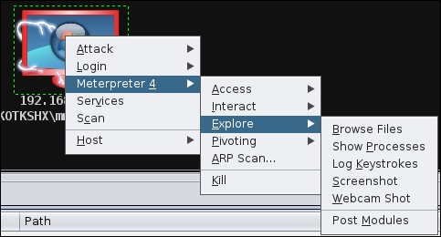
EternalBlue
Pre-Engagement
Intelligence Gathering
Threat Modeling
Vulnerability Analysis
Exploitation
Post-Exploitation
Reporting Flag
https://www.thec2matrix.com/matrix
http://www.pentest-standard.org/index.php/Main_Page
Notes:
Try dumping hashes from the machine and finding flags, think about the level of access you have to the machine right now. You could absolutely deploy ransomware at this stage.

Slide 40
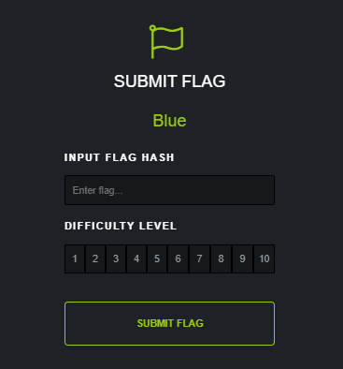
EternalBlue
Pre-Engagement
Intelligence Gathering
Threat Modeling
Vulnerability Analysis
Exploitation
Post-Exploitation
Reporting Flag
http://www.pentest-standard.org/index.php/Main_Page
Notes:
Get the host machine setup and our network connections working

Slide 41
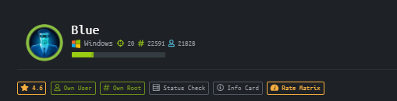
EternalBlue
Pre-Engagement
Intelligence Gathering
Threat Modeling
Vulnerability Analysis
Exploitation
Post-Exploitation
Reporting Flag
http://www.pentest-standard.org/index.php/Main_Page
Notes:
Get the host machine setup and our network connections working

Slide 42
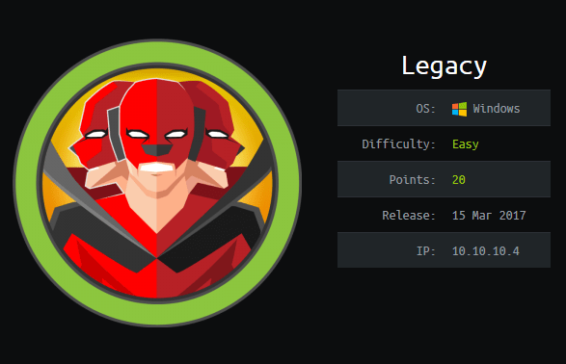
Legacy
Similar machine to Blue
We won’t be covering this today
If this was fun give it a try. Maybe without MS-17-010 this time ☺

Slide 43
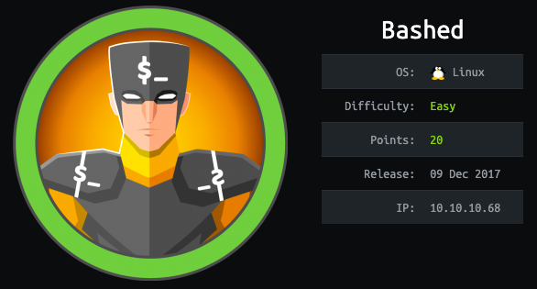
Bashed

Slide 44

Brief Story

Slide 45
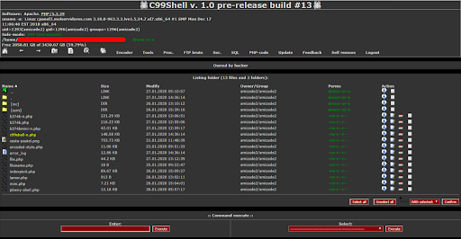

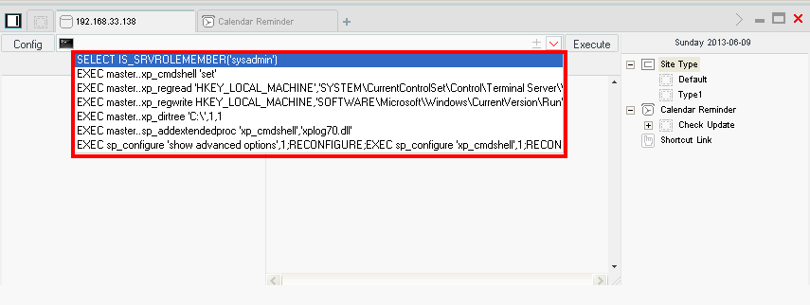
Brief Story
https://github.com/epinna/weevely3
https://www.fireeye.com/content/dam/fireeye-www/global/en/current-threats/pdfs/rpt-china-chopper.pdf

Slide 46
Hands-on


Slide 47
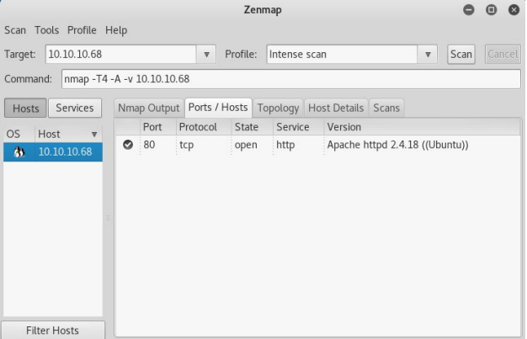
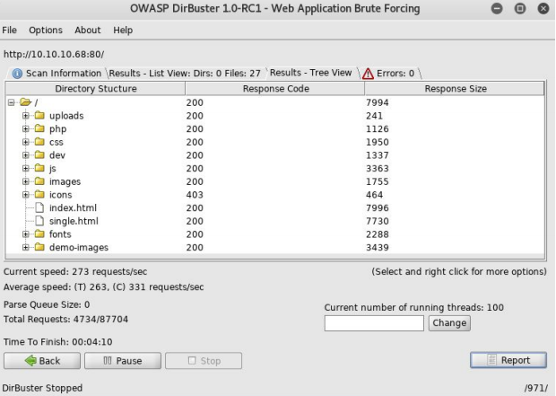
Walkthrough

Slide 48
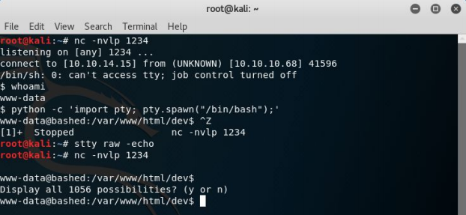
Reverse Shell

Slide 49
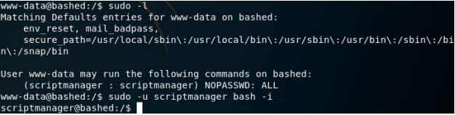
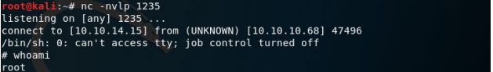
Privilege Escalation

Slide 50
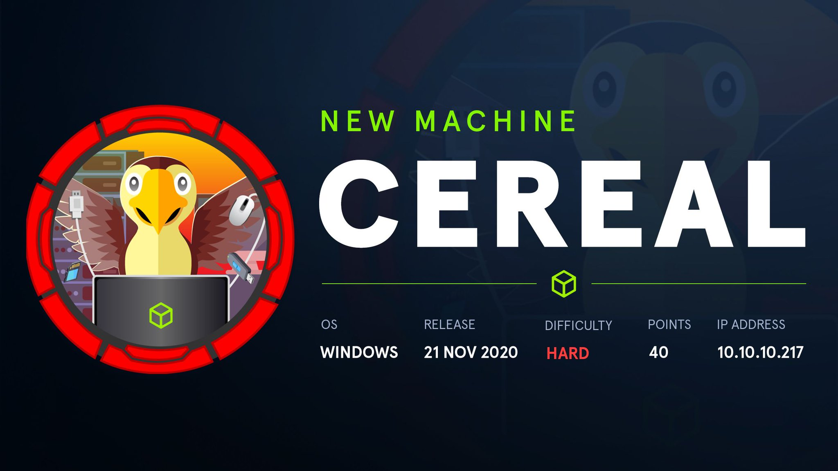
Cereal

Slide 51
Lab Time :

Slide 52
Feedback
Notes:
What I’d love to do is having people in upcoming meetings share stories that they themselves can tie back to machines on HackTheBox. Give talks about their relevant research and share as well. If you are interested in speaking please reach out, I’d love to have you.

